Slide 1
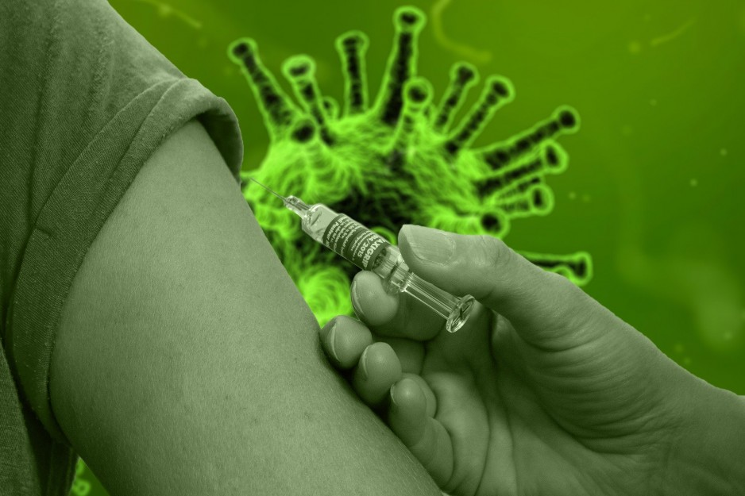
Prediction of Risks
Associated with Mass
Corona Vaccination
Group 10
E/17/040 : Madush Dilshan
E/17/356 : Shashini Upekha
E/17/407 : Hasara Wijesooriya

Slide 2
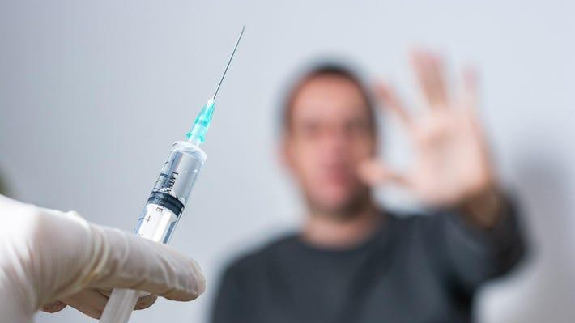
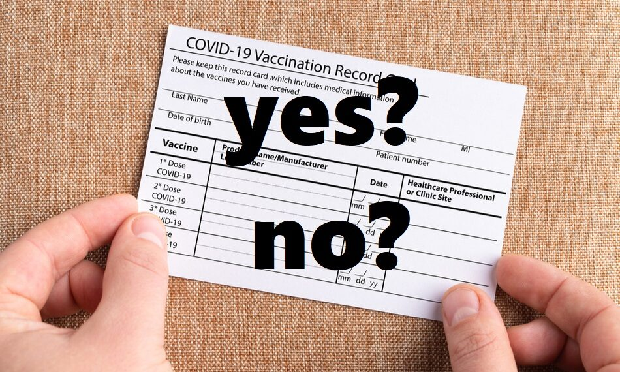
PROBLEM
Fear of getting side effects
spreading opinions
various myths
Society is doubtful of getting COVID-19 vaccines

Slide 3

TARGET AUDIENCE

Slide 4

OBJECTIVES
Derive and validate risk prediction algorithms to
estimate the risk of COVID-19 related to ,
mortality
hospital admission
side effects
after first ,second and the booster dose of vaccination.
Developing an Interactive website

Slide 5

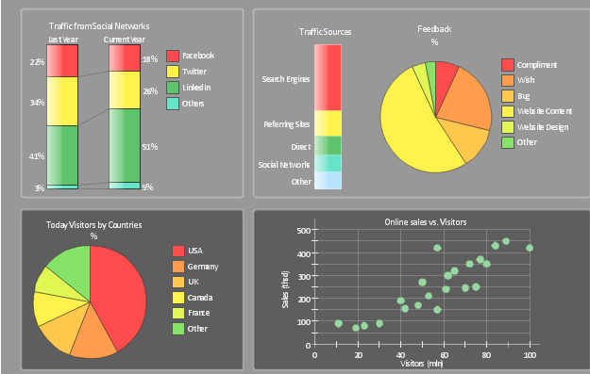
SOLUTION - Risk Predictor
Creating a comprehensive data set with data mining and other techniques.
Developing an interactive website with all the data , statistics , analytics and
visualization.

Slide 6

THINGS TO ANALYSE
Number of deaths, hospitalizations, and side effects,after the first dose, second dose or after booster dose with
age group
gender
height and weight (BMI)
vaccine type
blood group
district
habitual influences
self-reported comorbidities

Slide 7
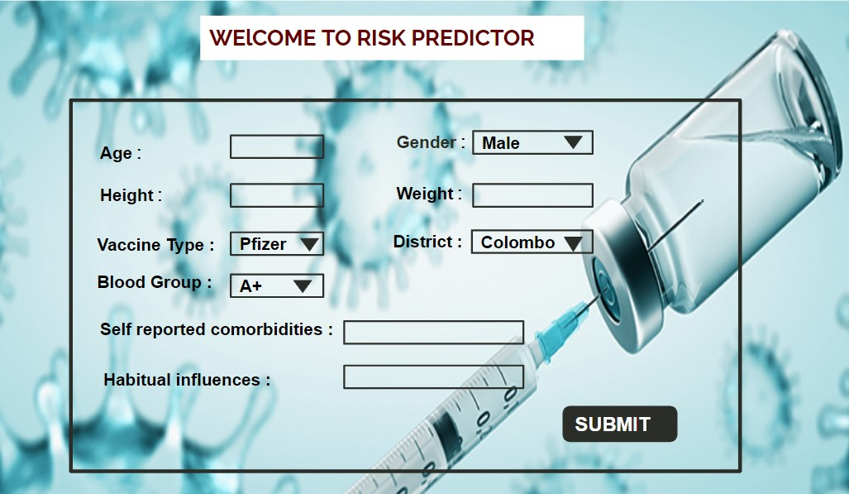
UI DESIGNS

Slide 8
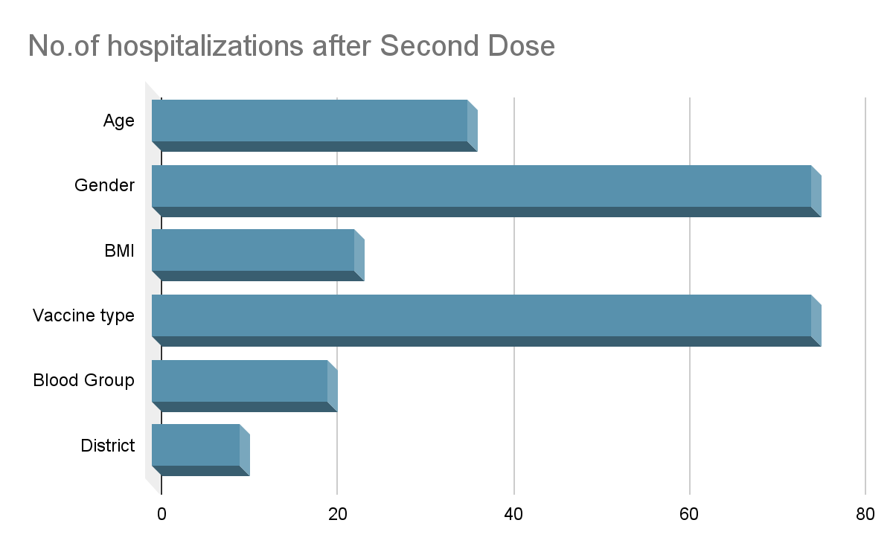
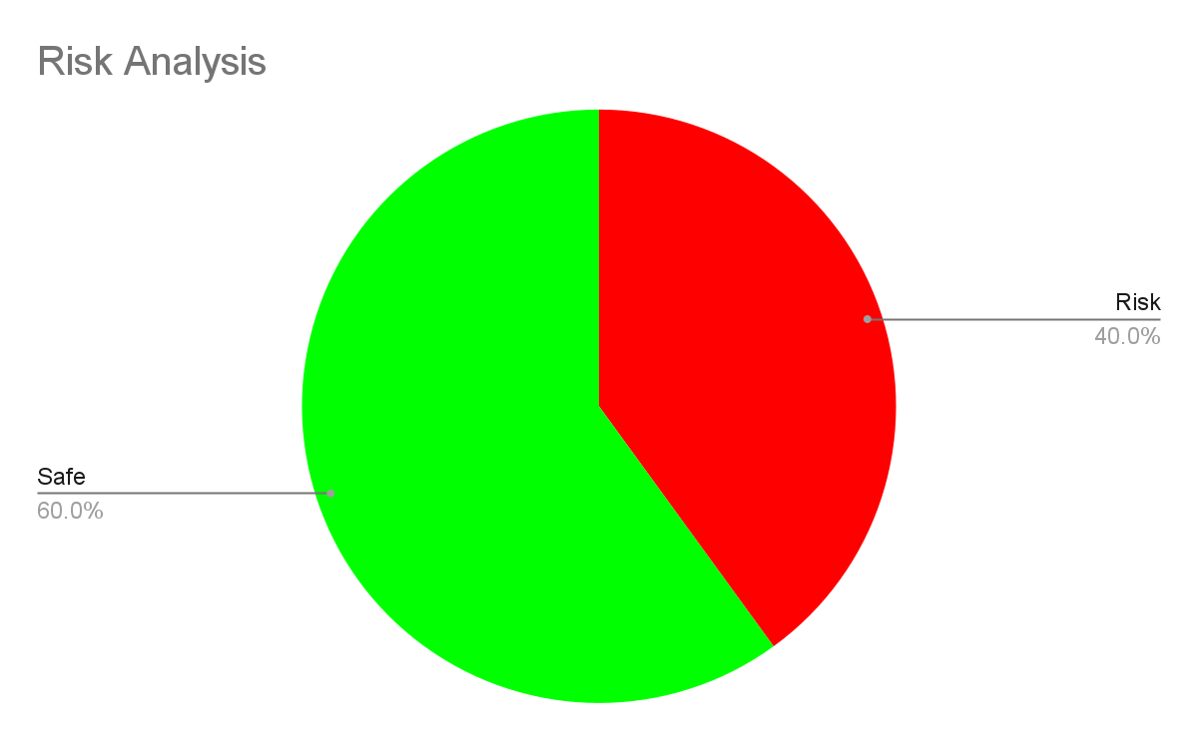

Slide 9

IMPACT ON BUSINESS VALUE AND FUTURE PLANS
Introduce the final product to the
hospitals
vaccine manufacturers

Slide 10
PLAN OF WORK
01
03
04
02
05
Design the front end and back end of web page
Problem Domain
identification
Testing and Integration
Data mining and analysis
Maintenance

Slide 11

OUR TEAM
Front end development
Back end development
Database management
Machine Learning and Data Mining
Agile methodologies
Committed to the team
Reliable and responsible
Communication skills
Project management
Flexible

Slide 12
Thank You !

Slide 13


